Slide 1
Next Generation UIs

Slide 2
Presentations and Demos Available At
https://github.com/Bowman74/MALModernUIs

Slide 3
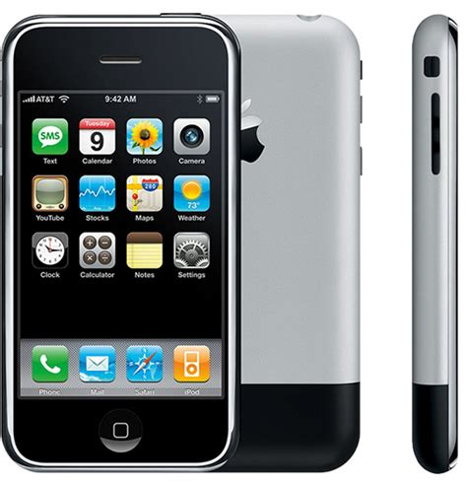
A revolutionary paradigm?
Smart Phones Changed How we interacted with Computers
Go anywhere we go
Interact with touches and gestures
Screens with pictures and animations
Almost always connected
A variety of sensors (accelerometer, GPS, Phone, cell and WIFI)

Slide 4
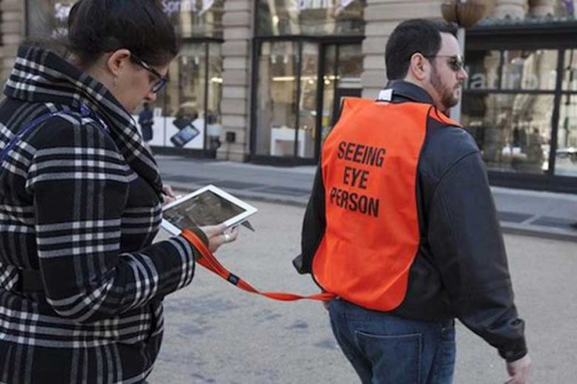
But that pattern had its problems

Slide 5
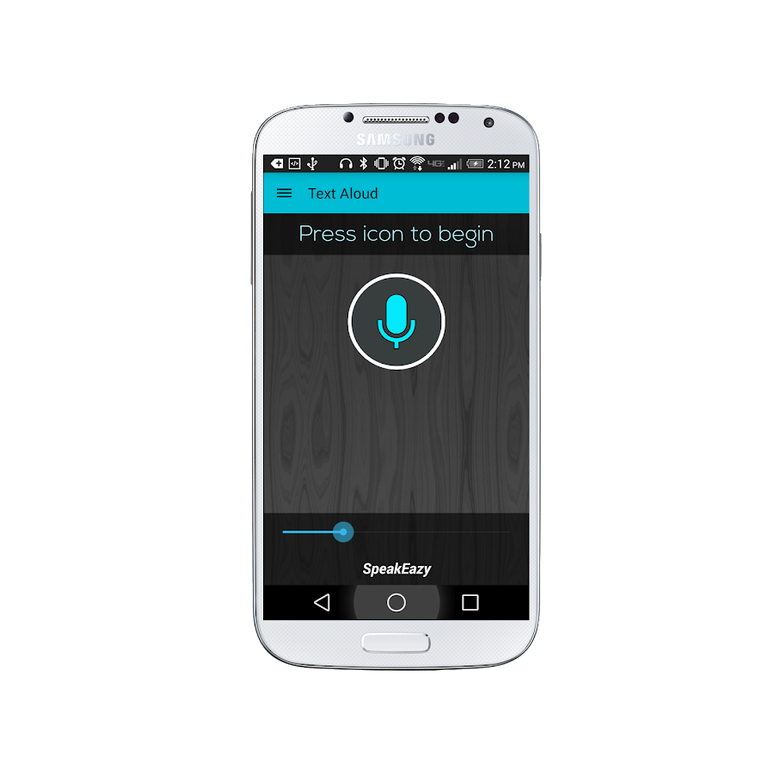
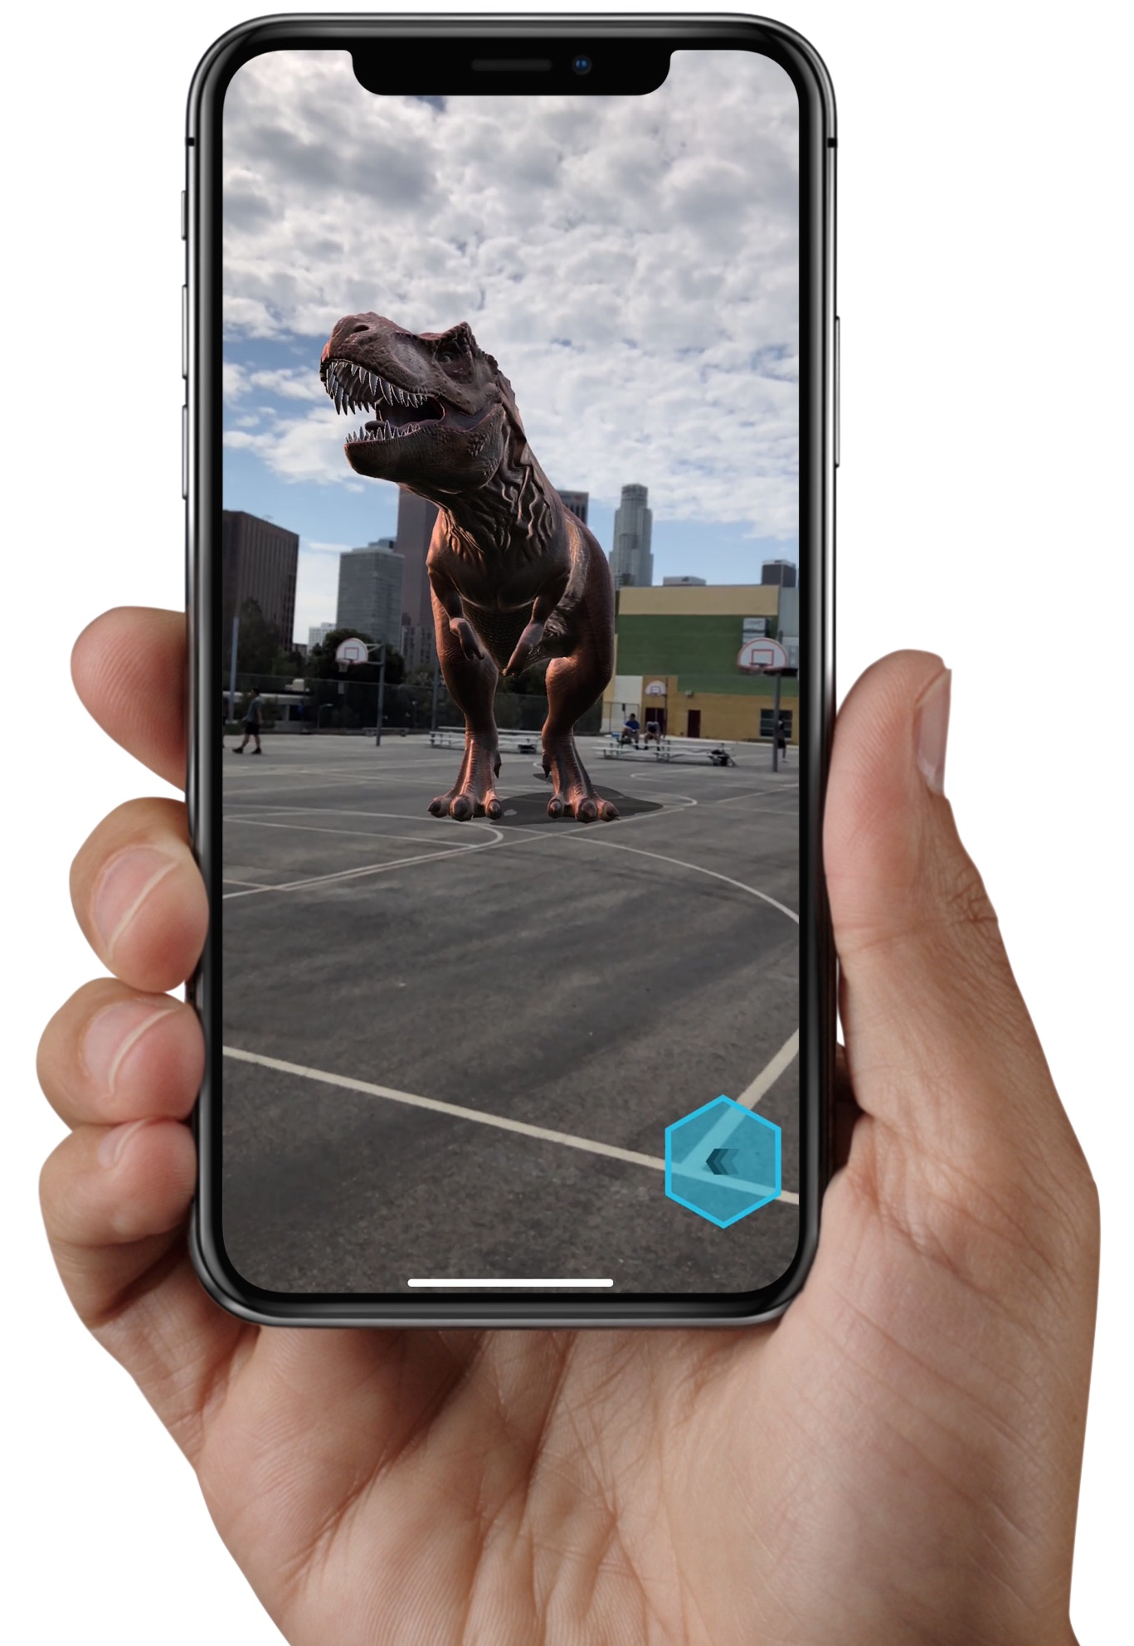
Emerging technologies and patterns to interact with

Slide 6
Conversational UIs - Text

Slide 7
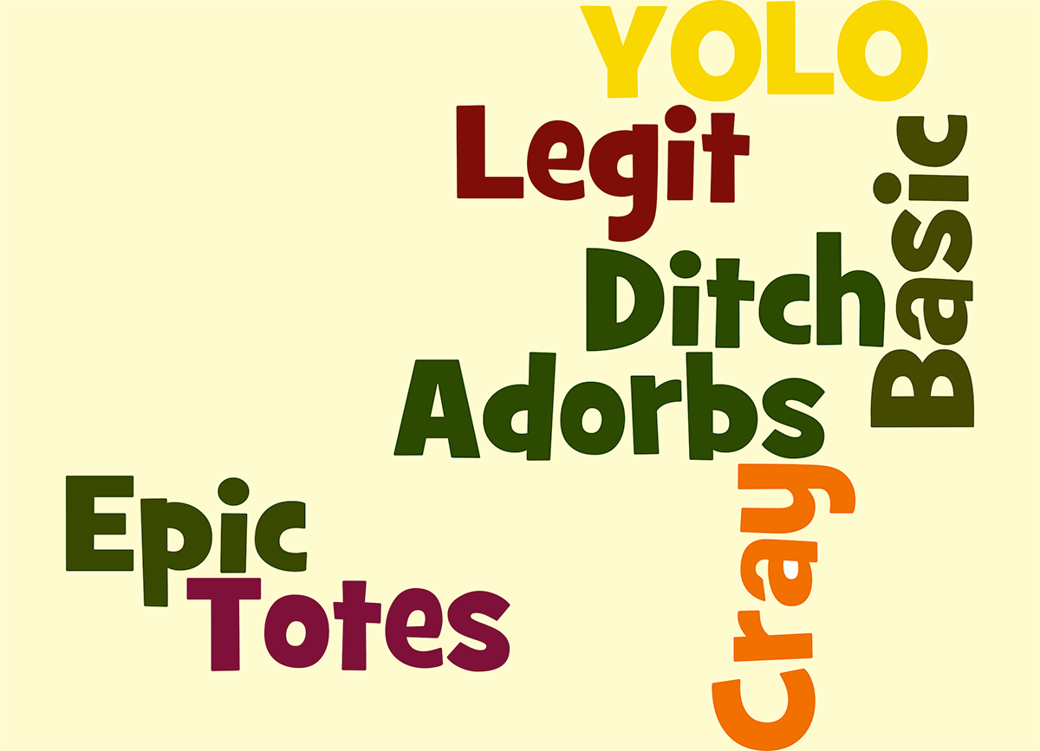
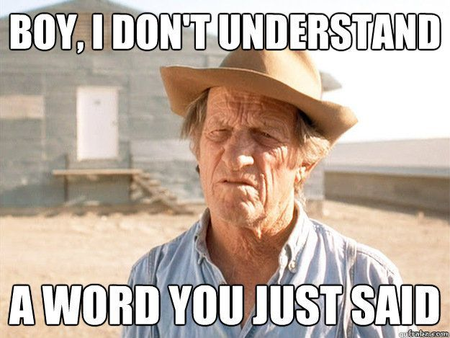
When to use language understanding?
Not a guided process but perhaps a selector for what they want to do
Simple interactions that can be expressed in multiple ways – Complex interactions? Use a Bot
When the same types of actions need to happen to different things
When interacting with a traditional data entry screen isn’t optimal
When you understand how your audience communicates

Slide 8

Simple Model Using Azure Luis
User entered text
Evaluation of entered text
Application Logic

Slide 9

Key Concepts
Entity
Intent
App -> Model
Training
Utterance
Role
Notes:
Entity – a list of replaceable elements that tell you something about what is being asked for
Intent – the type of interaction the user wants I want a new project
App – A collection of entities, intents and other items used to create a domain specific model
Training – the process of ensuring that the understanding of the conversation is what you expect
Utterance – input from the user that the app will interpret
Roles – How an entity is being used in an utterance. For example is a city a start location or destination?

Slide 10
LUIS Model Development
https://www.luis.ai/applications
Plan
Setup Intents and Entities
Train
Publish
Test
Prebuilt Domains
Model

Slide 11
Demo – Setting up a LUIS Model

Slide 12
Communicating with LUIS
User entered text
REST API
Evaluation of entered text
{Azure Service URL}?subscription-key={Key}&timezoneOffset=-360&q={user’s text}
Application Logic
JSON Response

Slide 13
Demo – Looking at a LUIS app

Slide 14
Expanding Our Simple Model
What does the user want to do?
Intent
Create a bug
Change a bug’s status
Close a bug

Slide 15
Outside of Our Custom App
Channels
Multi-Purpose Bot
Create a bug
Change a bug’s status
Close a bug

Slide 16
Conversational UIs - Voice

Slide 17
When to Use Voice?
Similar scripted and intent based flow as text based conversational UIs
When the user can’t look at or touch the device
When the device is within listening distance
When the environment is appropriate for listening
When you understand how your audience communicates

Slide 18
Simple Model Using Azure Voice
User’s voice
Converted text request
Converted text request
Evaluation of text
Application Logic

Slide 19
Demo – Using Azure Voice

Slide 20
Won’t that have Performance Implications?
Yes, also won’t support offline scenarios
Platform APIs are going to perform better
SpeechRecognizer
SiriKit

Slide 21
Image Recognition
Notes:
This is getting into the world of machine learning

Slide 22
When to Use Image Recognition?
There is access to a camera or digital photo library
When objects in the real world can provide information
When the evaluation of those objects fits the device limitations
(CPU or network)
Sufficient image quality
Hard to spot items / Patterns

Slide 23
Simple Model Using Azure Computer Vision
Image of handwritten request
Converted text request
Converted text request
Evaluation of text
Application Logic

Slide 24
Demo – Using Azure Computer Vision

Slide 25
Wait, won’t that have Performance Implications too?
Yes, also won’t support offline scenarios
Platform APIs are going to perform better
TensorFlow Lite
ARKit
TensorFlow Lite

Slide 26
Augmented Reality

Slide 27
Lions and Tigers and Bears, oh my!
Virtual Reality
Augmented Reality
Mixed Reality
Notes:
https://www.quora.com/What-is-the-difference-between-virtual-reality-augmented-reality-and-mixed-reality

Slide 28
When to Use Augmented Reality?
Device has AR capabilities (camera and ability to process)
When objects in the real world can provide information
AND when the application can add usable information to the real world
When the user can safely view the world through AR
Hard to spot items / Patterns

Slide 29
Simple Model Using ARKit
Camera Feed
Face we are looking for
Information to display on current bugs
Azure Dev Ops API

Slide 30
Wait No Azure?
Livestreaming video Takes Time
VR, AR, ML all use local processors
ARCore
ARKit
ARCore

Slide 31
Demo – How about a little AR?

Slide 32
Future of these Technologies
Seem rather tacked on to existing devices
Don’t walk into a fountain
Several attempts to get the formula right
At some point someone will

Slide 33
Q & A

